Slide 1
Boolean Algebra
We have seen how we can represent information in binary, now we will explore
  Why we use binary
  How to compute using binary
  How to implement binary operations using Boolean algebra (such as binary addition)
  How to implement Boolean algebra through digital circuits
  How to store things using digital circuits

Slide 2
Boolean Algebra
The basis for all digital circuits is Boolean algebra:
  Boolean algebra is the algebra of binary values
    or of 2 values
  we refer to these values as 0 and 1
    although we could also refer to them as true and false
The manipulation of Binary Information is done by Logic circuits called GATES.
    the basic Boolean algebra operations are
    AND , NAND(Invert of AND)
    OR , NOR(Invert of OR)
    NOT, Buffer(Invert of NOT)
    XOR
    X-NOR

Slide 3
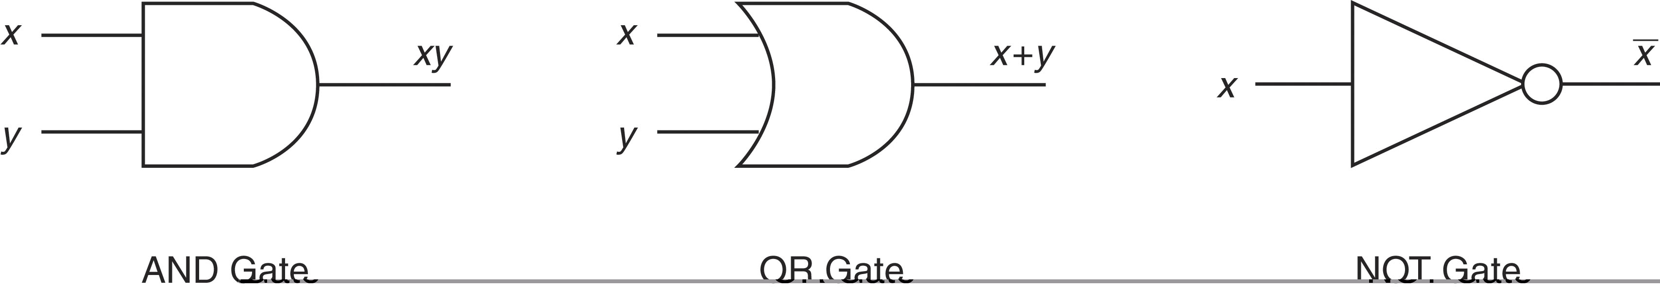
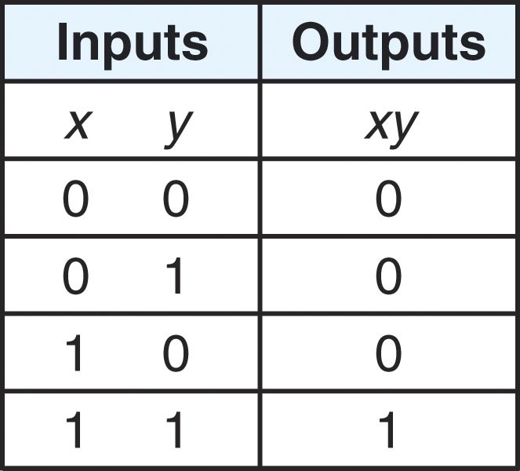
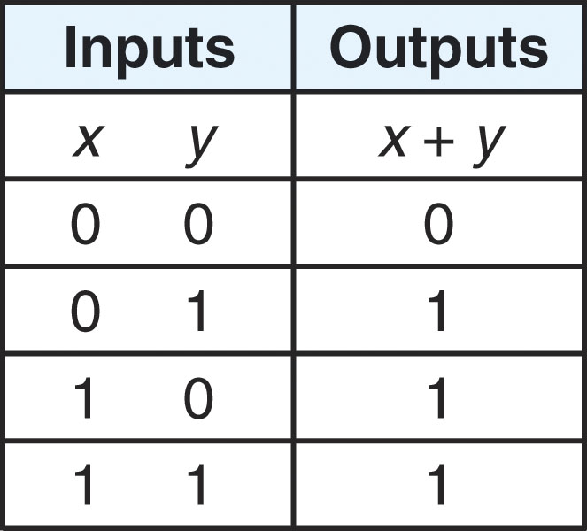
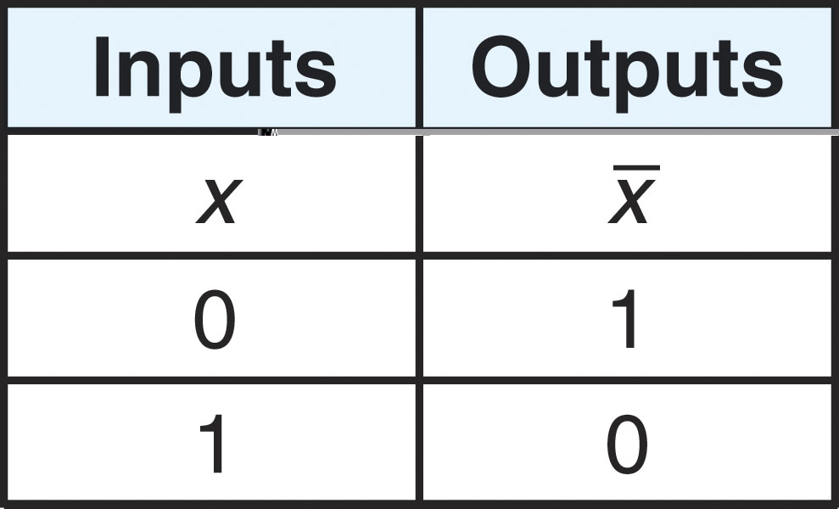
Introduction Of Gates
Truth Tables :
Algebric Function :
F= xy
Algebric Function :
F= x+y
Algebric Function :
F= x’

Slide 4
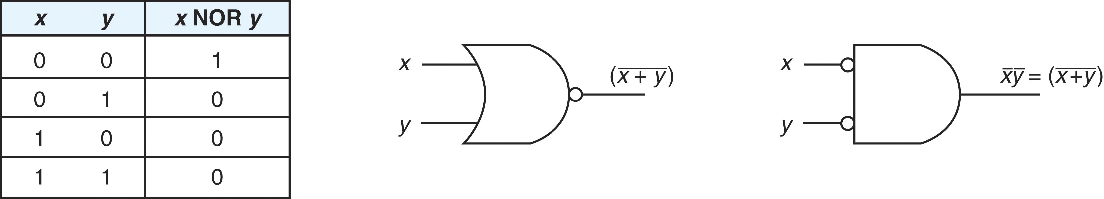
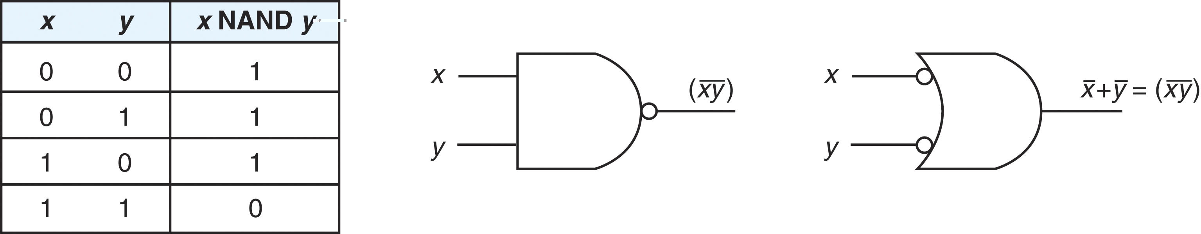
NOR & NAND Gates
NOR Gate
Algebric Function :
F= (X+Y)’
NAND Gate
Algebric Function :
F= (XY)’

Slide 5
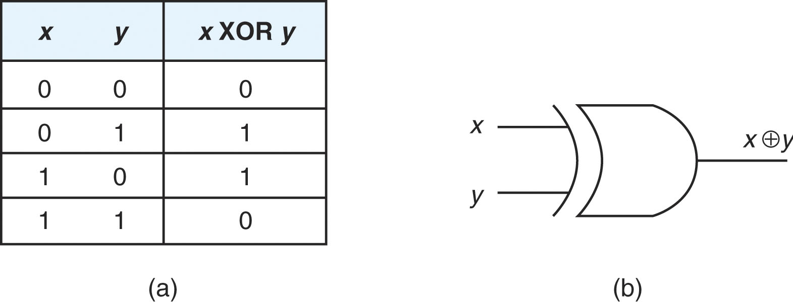

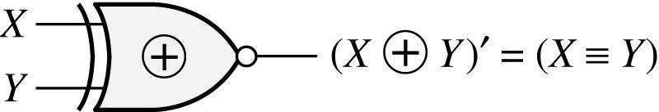
XOR & XNOR gates
Exclusive-OR (XOR) Gate :
Truth Tables :
Algebric Function
F = X’Y + XY’
Exclusive-NOR (XNOR) Gate :
Truth Tables :
Algebric Function
XY
0 0
0 1
1 0
1 1
1
0
0
1
F = X’Y’ + XY

Slide 6
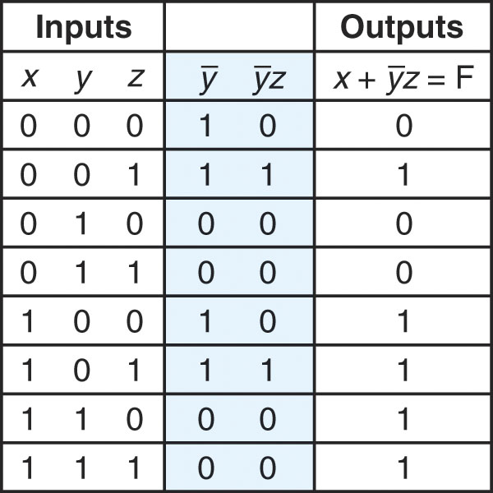
Boolean Expressions
We form Boolean expressions out of Boolean operations on Boolean variables or Boolean values
  So, like algebraic expressions, we can create more complex Boolean expressions as we might need
Consider the expression:
  F = X + Y’Z
What is it’s truth table?
Notice that it is easier to derive the
truth table for the entire expression
by breaking it into subexpressions
So first we determine Y’
next, Y’Z
finally, X + Y’Z

Slide 7
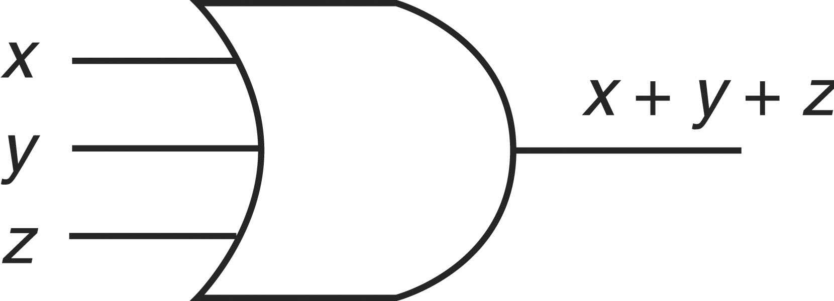
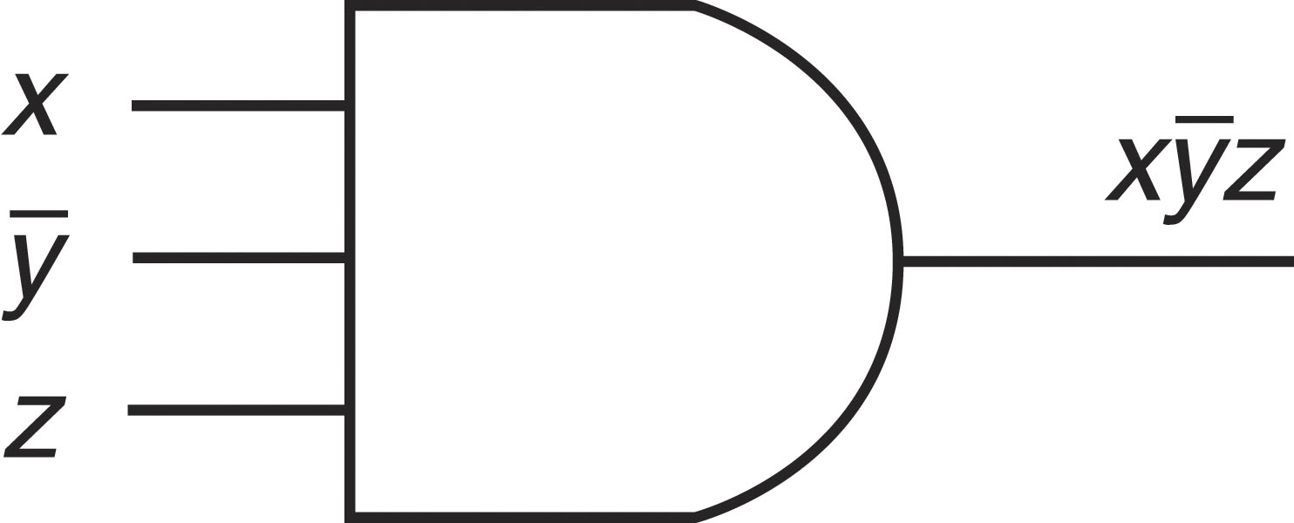
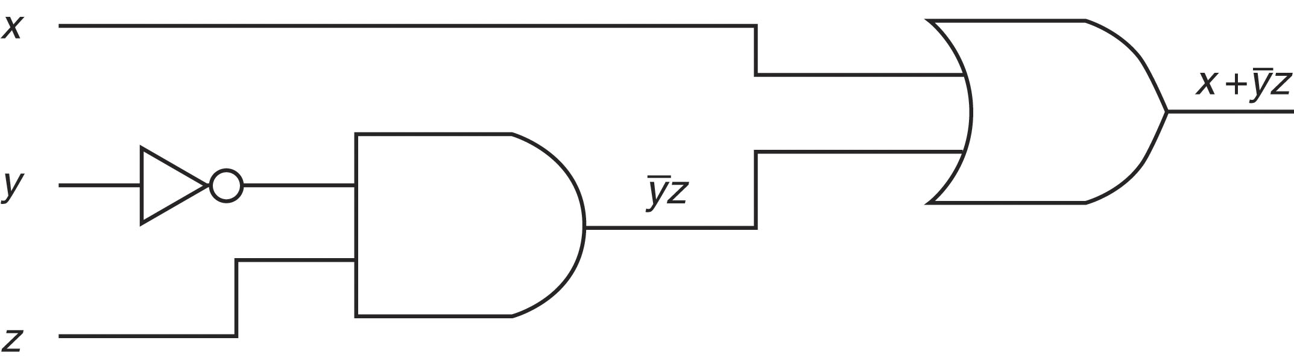
Circuit
AND and OR gates can have more than 2
inputs, as seen here
Notice for ~Y, we can either use a NOT gate or
simply specify that the value is ~Y
Here is the truth table for this last circuit

Slide 8
If Expresion Is So Lengthy Then
?

Slide 9
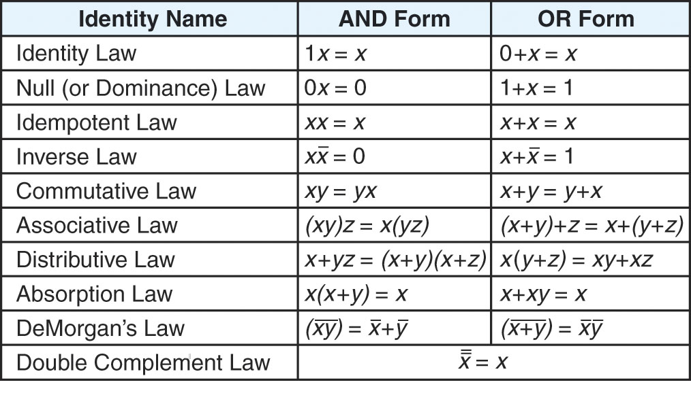
Basic Boolean Identities
As with algebra, there will be Boolean operations that we will want to simplify
  We apply the following Boolean identities to help
    For instance, in algebra, x = y * (z + 0) + (z * 0) can be simplified to just x = y * z

Slide 10
Example
Example: use algebraic simplification rules to reduce
F(1,4,5,6,7) = P(X,Y,Z) X’Y’Z+XY’Z’+XY’Z+XYZ’+XYZ
= X’Y’Z + XY’(Z’+Z)+XY(Z’+Z) (:. Z+Z’=1)
= X’Y’Z+XY’+XY
0
1 = X’Y’Z+X(Y+Y’) (:.Y+Y’=1)
2 = X’ Y’Z +X (TAKE X’=Y & Y’Z=Z)
3 = (X+X’)(Y’Z+X)
4
= 1*(X+Y’Z)
5
6 = X+Y’Z
7

Slide 11
Map Simplification
Karnaugh Map
If 2-variables then 4 Minterms
If 3-variables then 8 Minterms
If 4-variables then 16 Minterms
Overall K-Map returns the “Sum Of Product”

Slide 12
Map Simplification
2-variable 3-variable 4-variable
X
Y
0
1
YZ
X
00
01
11
10
CD AB | 00 | 01 | 11 | 10
00
01
11
10
0
0
1
1

Slide 13
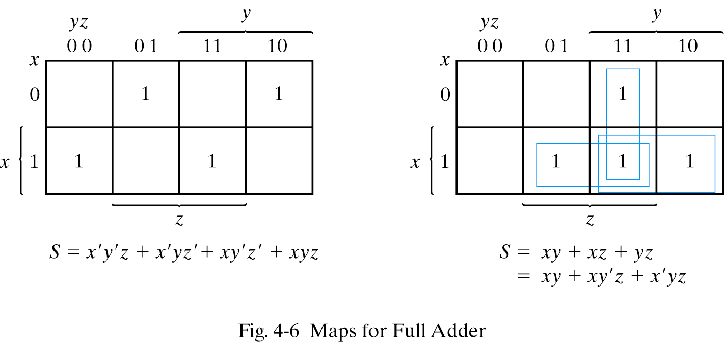
Map Simplification

Slide 14
4-VARIABLE K-MAP
CD AB | 00 | 01 | 11 | 10
00 | 1 | 0 | 0 | 1
01 | 0 | 0 | 0 | 1
11 |  |  |  | 1
10 | 1 | 0 |  | 1
CD AB | 00 | 01 | 11 | 10
00 | 1 |  | 1 | 1
01 |  | 1 | 1 | 1
11 | X | X | X | X
10 | 1 | 1 | X | X
B’D’+CD’
B’D’+A+C+BD

Slide 15
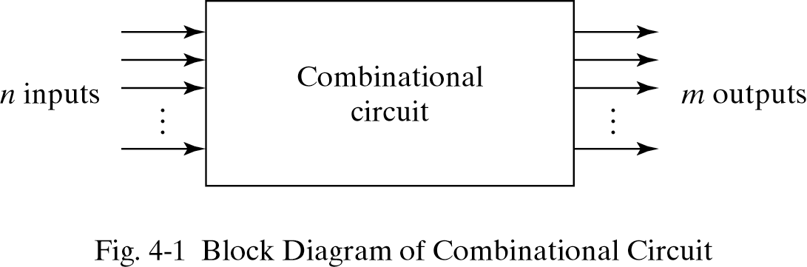
Combinational Circuits

Slide 16
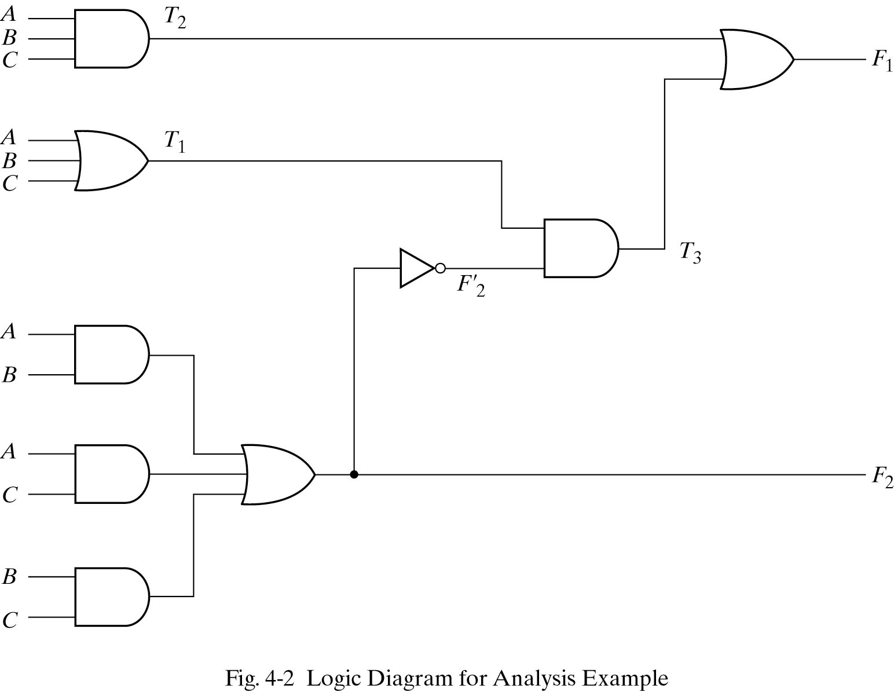

Slide 17
Designing Combinational Circuits
In general we have to do following steps:
Problem description
Input/output of the circuit
Define truth table
Simplification for each output
Draw the circuit

Slide 18
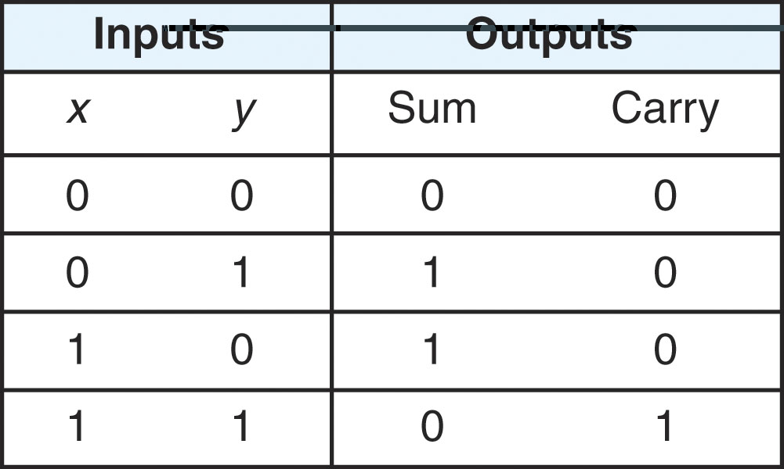
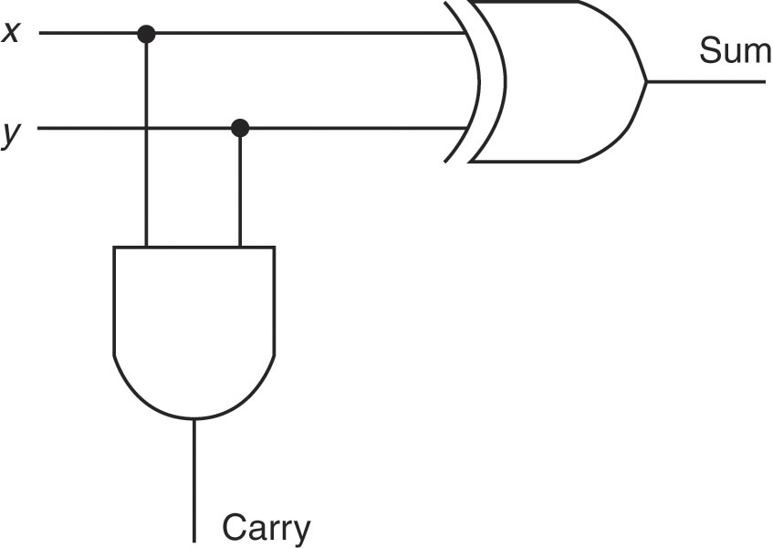
An Example: Half Adder
There are 4 possibilities when adding 2 bits together:
  0 + 0 0 + 1 1 + 0 1 + 1
    In the first case, we have a sum of 0 and a carry of 0
    In the second and third cases, we have a sum of 1 and a carry of 0
    In the last case, we have a sum of 0 and a carry of 1
    These patterns are demonstrated in the truth table above to the right
    SUM =X’Y + Y’X
    CARRY = XY
  Notice that sum computes the same as XOR and carry computes the same as AND
  We build an Adder using just one XOR and one AND gate
The truth table for Sum and Carry
and a circuit to compute these

Slide 19
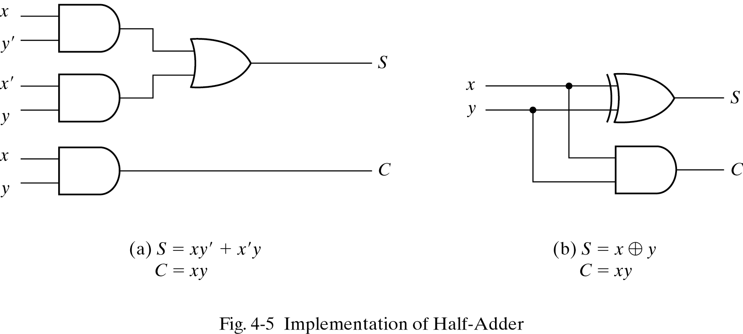

Slide 20
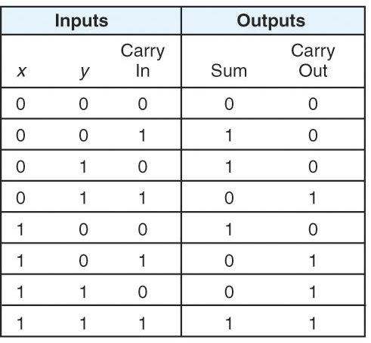
Full Adder
The half adder really only does half the work
  adds 2 bits, but only 2 bits
If we want to add 2 n-bit numbers, we need to also include the carry in from the previous half adder
  So, our circuit becomes more complicated
In adding 3 bits (one bit from x, one bit from y, and the carry in from the previous addition), we have 8 possibilities
  The sum will either be 0 or 1 and the carry out will either be 0 or 1
  The truth table is given to the right

Slide 22
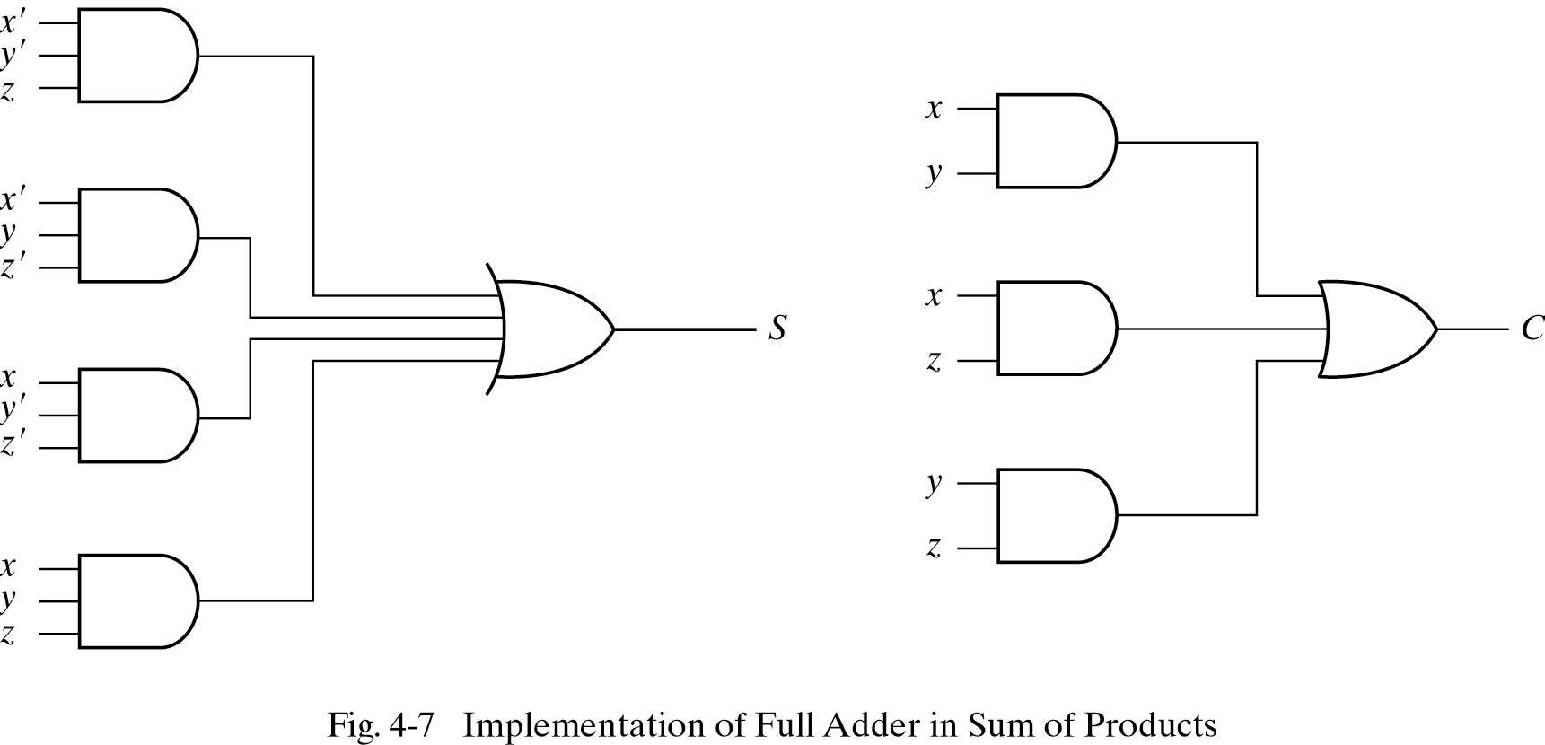

Slide 23
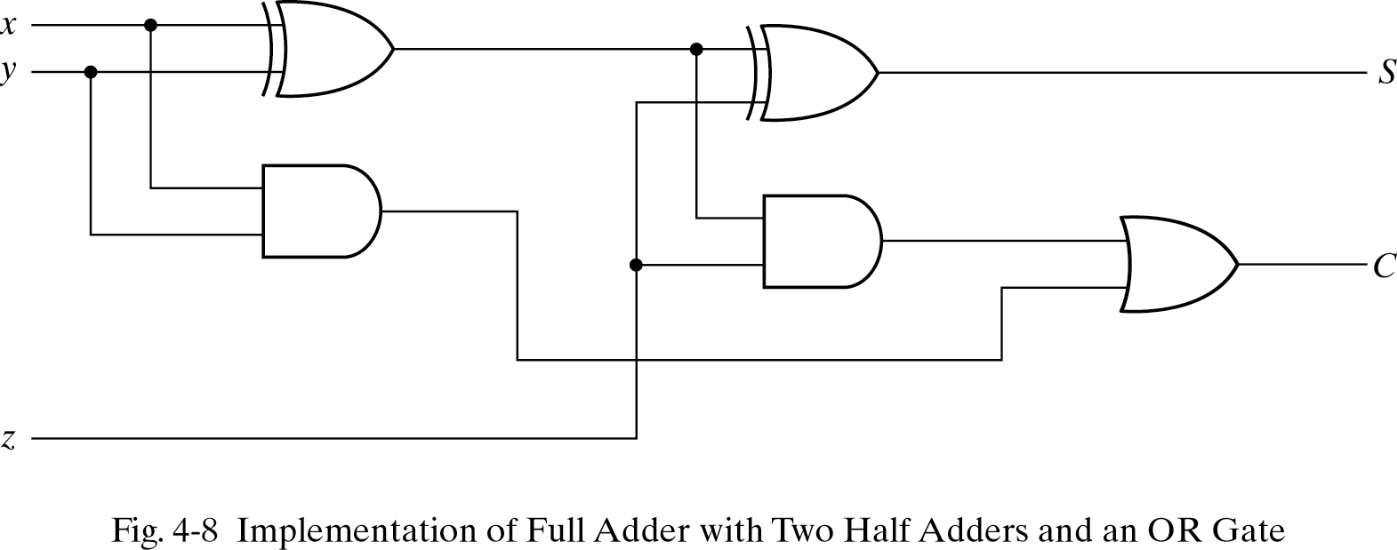

Slide 24

Thanking You
Queries?

